Slide 1

第5章 可归约性
本章内容及要求：
Instead of proving directly by the diagonalization method, we reduce the problem of deciding A_{TM} to the problem of deciding a language B => Reduction
Precisely, we show that if we know how to decide B (i.e., B is decidable), so can A_{TM}. In this way, we show that language B is undecidable

Slide 2
Reducibility

Slide 3
Chapter 5: Reducibility 可归约性
一种 化难为易 化繁为简 的方法 , ep173，cp118
归约的直观解释 ：调用，
问题 A官 , B兵, 对应C程序(TM)： Prog_官 ( w) ,Prog_兵(w)
如果 官调 兵 如下：
Prog_官(w)
{ ……
….. //简单计算
Prog_兵(w)
…… //简单计算
}
则称官 规约为 兵 ,
主调 被调
如果 B兵 能识别语言 L，则A官 也能
逆否定理 如果A官不能识别L, 则B兵 也不能 ， 我们用这一条
被调用者为核心技术

Slide 4


Problem is reduced to problem
If we can solve problem then
we can solve problem

Slide 5


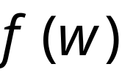


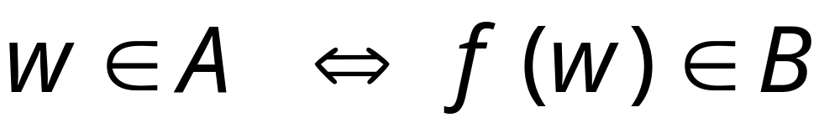
Definition:
Language
is reduced to
language
There is a computable
function (reduction) such that:

Slide 6


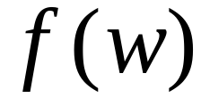
Recall:
Computable function :
There is a deterministic Turing machine
which for any string computes

Slide 7


Theorem:
If: a: Language is reduced to
b: Language is decidable
Then: is decidable
Proof:
Basic idea:
Build the decider for
using the decider for

Slide 8


Decider for
Reduction
Input
string
YES
accept
YES
accept
compute
Decider
for
(halt)
(halt)
NO
reject
NO
reject
(halt)
(halt)
END OF PROOF

Slide 9
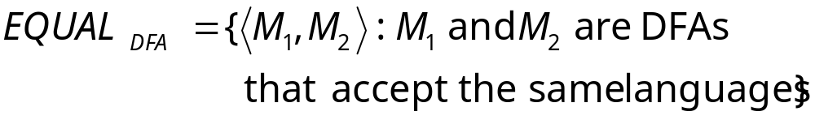
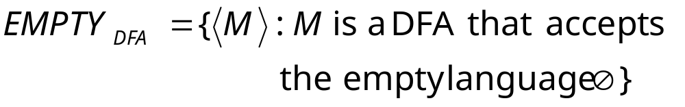
Example:
is reduced to:

Slide 10
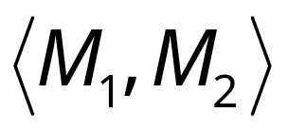
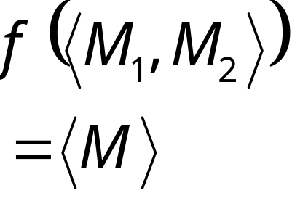

We only need to construct:
Turing Machine
for reduction
DFA

Slide 11

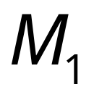

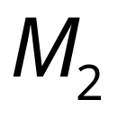

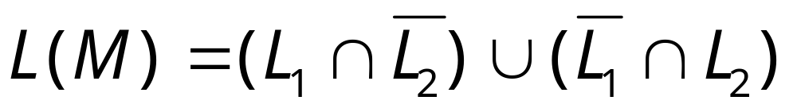
Let be the language of DFA
Let be the language of DFA
Turing Machine
for reduction
DFA
construct DFA
by combining and so that:

Slide 12
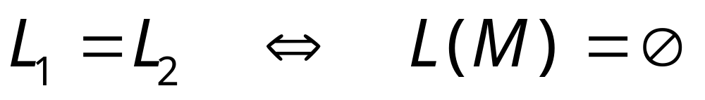

Slide 13
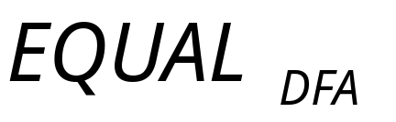
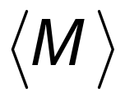
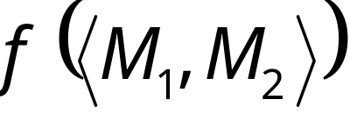
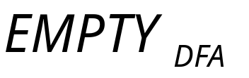
Decider for
Input
string
Reduction
YES
compute
YES
Decider
NO
NO

Slide 14
Theorem (version 1):
If: a: Language is reduced to
b: Language is undecidable
Then: is undecidable
(this is the negation of the previous theorem)
Proof:
Suppose is decidable
Using the decider for
build the decider for
Contradiction!

Slide 15

If is decidable then we can build:
Decider for
Reduction
Input
string
YES
accept
YES
accept
compute
Decider
for
(halt)
(halt)
NO
reject
NO
reject
(halt)
(halt)
CONTRADICTION!
END OF PROOF

Slide 16
Problem is reduced to problem
If is decidable then is decidable
If is undecidable then is undecidable

Slide 17


Observation:
In order to prove
that some language is undecidable
we only need to reduce a
known undecidable language
to

Slide 18
Reducibility Examples
(undecidable language)

Slide 19
Example:
the halting problem
is reduced to
the state-entry problem

Slide 20



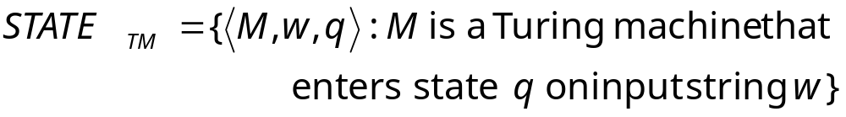
State-entry problem
Input:
Turing Machine
State
String
Question:
Does
enter state
while processing input string ?
Corresponding language:

Slide 21

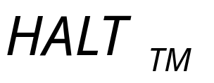
Theorem:
is undecidable
(state-entry problem is unsolvable)
Proof:
Reduce
(halting problem)
to
(state-entry problem)

Slide 22





We want to reduce the halting problem to
the state-entry problem:
Halting problem decider
halts on
enters
YES
YES
State-entry
problem
decider
NO
NO
dosenotenters
doesnothalts on

Slide 23
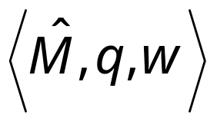
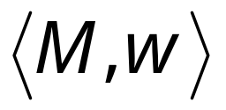
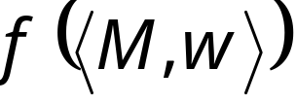
Halting Problem Decider
Decider for
state-entry problem
decider
Reduction
YES
Compute
Decider
YES
NO
NO
Given the reduction,
if is decidable,
then is decidable
A contradiction!
since
is undecidable
Notes:
We need to convert one problem instance
to the other problem instance

Slide 24
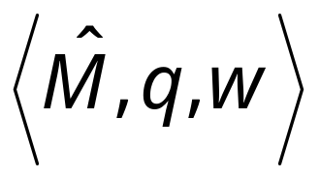

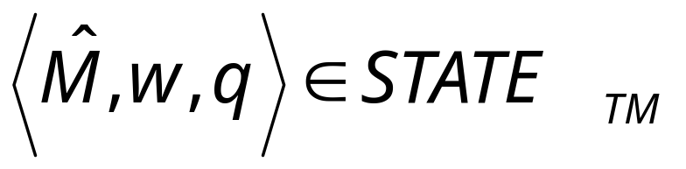
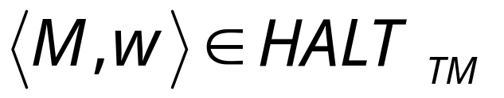
We only need to build the reduction:
Reduction
Compute
So that:

Slide 25


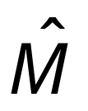

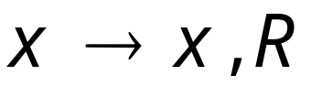

Construct from :
special
halt state
halting
states
A transition for every unused
tape symbol of

Slide 26


special
halt state
halting
states
halts
halts on state

Slide 27
Therefore:
halts on input
halts on state on input
Equivalently:
END OF PROOF

Slide 28

Blank-tape halting problem
Input:
Turing Machine
Question:
Does
halt when started with
a blank tape?
Corresponding language:

Slide 29

Theorem:
is undecidable
(blank-tape halting problem is unsolvable)
Proof:
Reduce
(halting problem)
to
(blank-tape problem)

Slide 30
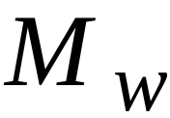
We want to reduce the halting problem to
the blank-tape halting problem:
Halting problem decider
halts on
halts on
blank tape
YES
Blank-tape
halting problem
decider
YES
NO
NO
doesn’t halts
onblank tape
doesnothalts on

Slide 31

Halting Problem Decider
Decider for
blank-tape problem
decider
Reduction
YES
Compute
Decider
YES
NO
NO
Given the reduction,
If is decidable,
then is decidable
A contradiction!
since
is undecidable

Slide 32

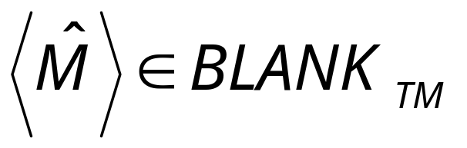
We only need to build the reduction:
Reduction
Compute
So that:

Slide 33




Construct from :
no
Tape is blank?
yes
Run
Write on tape
with input
If halts then halt

Slide 34
no
Tape is blank?
yes
Run
Write on tape
with input
halts on input
halts when started on blank tape

Slide 35
halts on input
halts when started on blank tape
Equivalently:
END OF PROOF

Slide 36
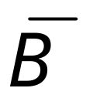
Theorem (version 2):
If: a: Language is reduced to
b: Language is undecidable
Then: is undecidable
Proof:
Suppose is decidable
Then is decidable
Using the decider for
build the decider for
Contradiction!

Slide 37


Suppose is decidable
reject
Decider
for
(halt)
accept
(halt)

Slide 38

Suppose is decidable
Then is decidable
(we have proven this in previous class)
Decider for
NO
reject
YES
accept
Decider
for
(halt)
(halt)
YES
NO
accept
reject
(halt)
(halt)

Slide 39

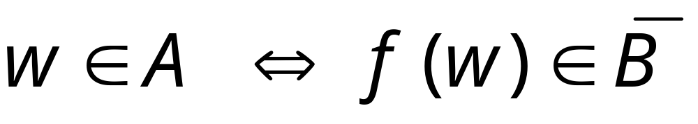
If is decidable then we can build:
Decider for
Reduction
Input
string
YES
accept
YES
accept
compute
Decider
for
(halt)
(halt)
NO
reject
NO
reject
(halt)
(halt)
CONTRADICTION!

Slide 40
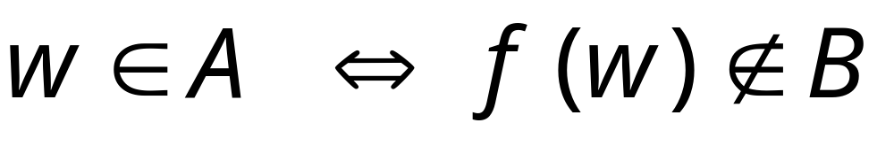
Alternatively:
Decider for
Reduction
Input
string
NO
reject
YES
accept
compute
Decider
for
(halt)
(halt)
YES
NO
accept
reject
(halt)
(halt)
CONTRADICTION!
END OF PROOF

Slide 41
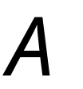

Observation:
In order to prove
that some language is undecidable
we only need to reduce some
known undecidable language
to
or to
(theorem version 1)
(theorem version 2)

Slide 42
Uncomputable Functions

Slide 43

Uncomputable Functions
Values
region
Domain
A function is uncomputable if it cannot
be computed for all of its domain

Slide 44
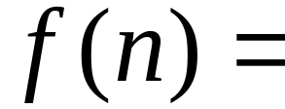

An uncomputable function:
maximum number of moves until
any Turing machine with states
halts when started with the blank tape

Slide 45
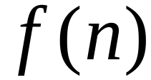
Theorem:
Function is uncomputable
Proof:
Assume for contradiction that
is computable
Then the blank-tape halting problem
is decidable

Slide 46

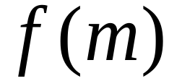
Decider for blank-tape halting problem:
Input: machine
1. Count states of :
2. Compute
3. Simulate for steps
starting with empty tape
If halts then return YES
otherwise return NO

Slide 47
Therefore, the blank-tape halting
problem is decidable
However, the blank-tape halting
problem is undecidable
Contradiction!!!

Slide 48
Therefore, function is uncomputable
END OF PROOF

Slide 49
Reducibility
Suppose you think L is undecidable.
How do you know for sure?
Show:
If some TM R decides L
then using R, I can build another TM S
so that S decides A_{TM}
...but this is impossible, because A_{TM} is undecidable.

Slide 50
Example 1
AEPS_{TM} = {〈M〉: M is a TM that accepts input ε}
decidable
undecidable
Step 1: You gotta believe it
  To know if M accepts ε, it looks like we have to simulate it
  But then we might end up in a loop
Step 2: Prove it!

Slide 51
Example 1: Figuring out the reduction
〈M’〉
R
accept if M’ accepts ε
reject if not
S
accept
if M accepts w
〈M, w〉
R
〈M’〉
reject
if not
M’ should be a Turing Machine such that:
If M accepts w, then M’ accepts ε
If M does not accept w, then M’ does not accept ε
M’ on input ε = M on input w

Slide 52
Example 1: Implementing the reduction
〈M, w〉
construct
M’
〈M’〉
M’ should be a Turing Machine such that:
M’ on input ε = M on input w
M’ := On input ε,
Simulate M on input w
If M accepts w, accept
Otherwise, reject

Slide 53
Example 1: Impementing the reduction
accept
if M accepts w
〈M, w〉
construct
M’
R
〈M’〉
reject
if not
S := On input 〈M, w〉:
Construct the following TM M’:
M’ := On input ε
Simulate M on input w and output answer
Run R on input 〈M’〉 and output its answer.

Slide 54
Example 1: Writing it up
undecidable
AEPS_{TM} = {〈M〉: M is a TM that accepts input ε}
A_{TM} = {〈M, w〉: M is a TM that accepts input w}
Suppose AEPS_{TM} is decidable and R decides it. Let
S := On input 〈M, w〉 where M is a TM and w is a string
Construct the following TM M’:
M’ := On input z,
Simulate M on input w and output answer
Run R on input 〈M’〉 and output its answer.
Then S accepts 〈M, w〉 if and only if M accepts w
So S decides A_{TM}, which is impossible.

Slide 55
Example 2
SOME_{TM} = {〈M〉: M is a TM that accepts some input}
decidable
undecidable
Step 1: You gotta believe it
  To know if M is in SOME_{TM}, looks like we have to simulate
  But then we might end up in a loop
Step 2: Prove it!

Slide 56
Example 2: Setting up the reduction
SOME_{TM} = {〈M〉: M is a TM that accepts some input}
Show: If SOME_{TM} can be decided by some TM R,
〈M’〉
R
accept if M’ accepts some input
reject if M’ accepts no inputs
... then A_{TM} can be decided by some other TM S
S
accept if M accepts w
〈M, w〉
reject if not

Slide 57
Example 2: Setting up the reduction
accept
if M accepts w
〈M, w〉
construct
M’
R
〈M’〉
reject
if not
Task
Given 〈M, w〉, construct M’ so that:
If M accepts w,
then M’ accepts some input
If M does not accept w,
then M’ accepts no inputs

Slide 58
Example 2: Implementing the reduction
Task
Given 〈M, w〉, construct M’ so that:
If M accepts w,
then M’ accepts some input
If M does not accept w,
then M’ accepts no inputs
M’ := On input z,
Simulate M on input w
If M accepts, accept
Otherwise, reject

Slide 59
Example 2: Writing it up
undecidable
SOME_{TM} = {〈M〉: M is a TM that accepts some input}
A_{TM} = {〈M, w〉: M is a TM that accepts input w}
Suppose SOME_{TM} is decidable and R decides it. Let
S := On input 〈M, w〉 where M is a TM and w is a string
Construct the following TM M’:
M’ := On input z,
Simulate M on input w and output answer
Run R on input 〈M’〉 and output its answer.
Then S accepts 〈M, w〉 if and only if M accepts w
So S decides A_{TM}, which is impossible.

Slide 60
Example 3
E_{TM} = {〈M〉: M is a TM that accepts no input}
decidable
undecidable
Show: If E_{TM} can be decided by some TM R,
... then SOME_{TM} can be decided by another TM S
SOME_{TM} = {〈M〉: M is a TM that accepts some input}

Slide 61
Example 3
undecidable
E_{TM} = {〈M〉: M is a TM that accepts no input}
SOME_{TM} = {〈M〉: M is a TM that accepts some input}
Suppose E_{TM} can be decided by some TM R.
Consider the following TM S:
S := On input 〈M〉 where M is a TM
Run R on input 〈M〉.
If R accepts, reject. If R rejects, accept.
Then S decides SOME_{TM}, a contradiction.

